Slide 1
Integrated Coastal Zone Management
Unit 7: Integrated coastal planning

Slide 2
Introduction
Unit content
Producing a coastal management plan:
Defining the study area
Identifying principal coastal problem
Identifying vulnerability
Identifying stakeholder groups relevant to problem
Construct and combine problem trees
Construct and combine objective trees
Identifying opportunities and constraints to achieving objectives
Conclusion

Slide 3
Introduction
Learning outcomes
Upon completion of this unit, students will be able to :
Prioritise and analyse coastal problems
Identify strategies to address principal problem
Justify stakeholder participation in strategy
Evaluate progress in achieving outcomes

Slide 4
Introduction
This unit brings together previous material and lasts all day!
It involves small group work – 4 or 5 people per group maximum
All work will be organised and timed so that each group prepares its own plan
Each group will need to organise itself
All members should contribute
One person should record all decisions by the group
Groups can move and work in different spaces if that helps

Slide 5
1. Define the area
Task 1 (15 mins)
Choose a case study coastal region with which all group members are familiar
This can be rural or urban
but should be ideally relatively small (helps in identifying threats) and in need of management (threats are present)
Inform the class leader of your region

Slide 6
2. Identify main problem
Task 2 (20 mins)
What human activity/activities present the most important problem in your case study region?
Consider all possible problems. Use pair-wise ranking to help
Record your discussion and be prepared to explain your decision
Pair-wise ranking
 | A | B | C | D
A |  | A | C | D
B |  |  | C | D
C |  |  |  | D
D
Compare all combinations (A or B; A or C; etc) and decide which is most important in each case
Add together and identify most important problem
Example table: D=3; C=2; A=1...therefore D is most significant

Slide 7
3. Vulnerability
Task 3 (15 mins)
Is your case study vulnerable to the problem?
Vulnerability of coast reflects combination of
scale: are the impacts localised or large scale?
timing: are the impacts short term or long term?
magnitude: are the impacts direct or indirect?
certainty: are the impacts inevitable or is there any doubt?
Are there particular ecological factors affecting vulnerability?
eg highly sensitive habitats
Discuss and record your decision

Slide 8
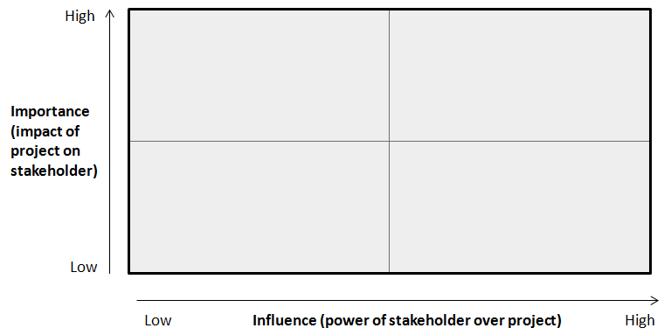
4. Stakeholders and participation
Task 4 (45 mins)
Identify the stakeholders of relevance to your case study and threat
Use the matrix to group
stakeholders by influence
and importance
Define a suitable and
effective participation
strategy for each group
in your matrix

Slide 9
5a. Constructing problem trees
Task 5a (40 mins)
Identify the key stakeholders of relevance to your case study and problem
Construct a problem tree for each key stakeholder group focusing upon the problem
This will mean more than one problem tree being constructed

Slide 10
5b. Combining problem trees
Task 5b (20 mins)
The goal is to derive one problem tree per class group
This will require each class group to identify common causes and effects from each problem tree, minimising the differences between each key stakeholder’s problem tree
Where it is not possible to combine problem trees, make a note and be prepared to explain why

Slide 11
6a. Constructing objective trees
Task 6a (25 mins)
Re-define your key problem as an objective
Construct an objective tree for each key stakeholder group

Slide 12
6b. Combining objective trees
Task 6b (40 mins)
The goal is to derive one objective tree
This will require each class group to identify common means and outcomes from each problem tree, minimising the differences between each key stakeholder’s objective tree
Where it is not possible to combine objective trees, make a note and be prepared to explain why

Slide 13
7. Opportunities and constraints
Task 7 (30 mins)
Consider your group’s final problem tree
- Which of the causes would be best dealt with by local coastal managers? Why?
- Which of the causes would be best dealt with at the regional or national level? Why?
Consider your group’s final objective tree
- Which of the means (ie policies) would be best implemented by local coastal managers? Why?
- Which of the policies would be best implemented at the regional or national level? Why?

Slide 14
8. Conclusion
Each group has worked through stages needed to produce an integrated coastal management plan
There are other elements to ICZM, but identifying threats and policies which generate most support from stakeholders is essential
Assessment
Individual report summarising this group exercise. Guidance on the report structure and length is provided in the accompanying material for this course.

